Slide 1
Space Time Tradeoffs

Slide 2
Gaining Time
Input Enhancement: can save time by preprocessing input
Horspool’s Algorithm for String Matching
Counting Methods for Sorting
Prestructuring: Use extra space to facilitate more flexible access.
Hashing
Indexing with B-Trees
Dynamic Programming: next chapter.

Slide 3
Gaining Space
Compression algorithms: chapter 9
Space and Time not always in direct conflict.

Slide 4
Input Enhancement for String Matching

Slide 5
String Matching
Given a string of n characters called the text and a string of m characters (m ≤ n) called the pattern, find a substring of the text that matches the pattern and return the starting index of the first matching substring.
Also commonly termed “needle” and “haystack”
Brute Force algorithm: O(n*m)

Slide 6

Horspool’s Algorithm
Like brute force approach, line pattern up against text and compare letter by letter.
When find a mismatch, want to shift as much as possible (instead of just by one).
Consider this by looking at letter c, which is aligned against last letter of pattern.
4 possible outcomes

Slide 7
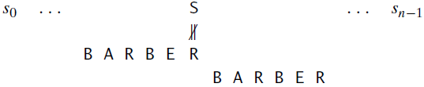
Horspool’s Algorithm
Case 1: no c’s in pattern
Can safely shift m spaces.

Slide 8
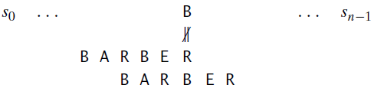
Horspool’s Algorithm
Case 2: there are occurrences of c in pattern
Shift so that rightmost occurrence of c aligns with c in text.

Slide 9
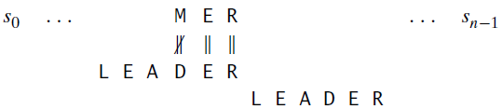
Horspool’s Algorithm
Case 3: the last letter of pattern is only occurrence of c.
Can safely shift m spaces.

Slide 10
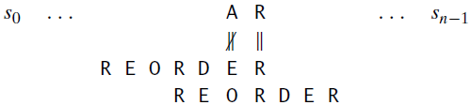
Horspool’s Algorithm
Case 4: letter c is last letter and occurs in another position earlier in the pattern.
Shift so that next rightmost occurrence of c aligns with c in text.

Slide 11
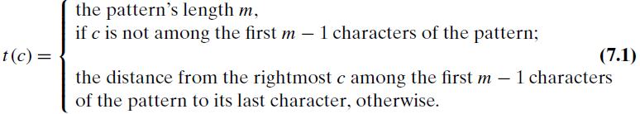
Shift Table
To speed up shifting, pre-compute for each letter c, the shift factor:
What would shift table be for pattern BARBER?

Slide 12
Shift Table
To speed up shifting, pre-compute for each letter c, the shift factor:
A | 4 |  | F | 6 |  | K | 6 |  | P | 6
B | 2 |  | G | 6 |  | L | 6 |  | Q | 6
C | 6 |  | H | 6 |  | M | 6 |  | R | 3
D | 6 |  | I | 6 |  | N | 6 |  | S | 6
E | 1 |  | J | 6 |  | O | 6 |  | … | …

Slide 13
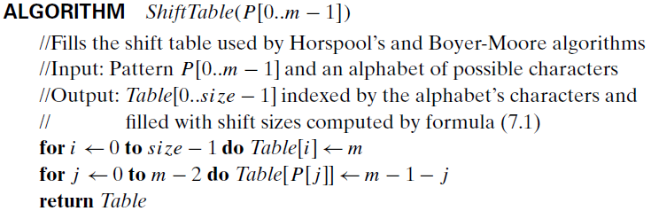
Computing Shift Table

Slide 14
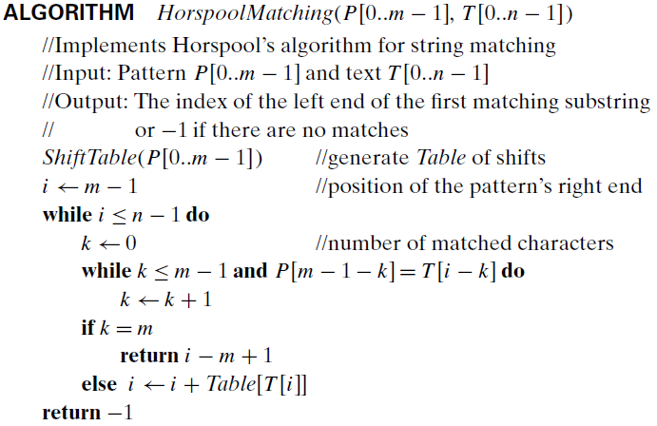
Horspool’s Algorithm

Slide 15
Example
Run Horspool’s Algorithm on following text and pattern: JIM_SAW_ME_IN_A_BARBERSHOP BARBER

Slide 16
Efficiency
Efficiency of Horspool’s Algorithm
Worst Case: O(nm)
Average Case: O(n)
Boyer-Moore Algorithm: similar idea to Horspool.
Worst Case: O(n)

Slide 17
Sorting by Counting
Input Enhancement

Slide 18
Input Enhancement
For each element of list to be sorted, count number of smaller elements
Yields index of element in sorted list.
Array
62 | 31 | 84 | 96 | 19 | 47
Count
0 | 0 | 0 | 0 | 0 | 0

Slide 19
Input Enhancement
For each element of list to be sorted, count number of smaller elements
Yields index of element in sorted list.
Array
62 | 31 | 84 | 96 | 19 | 47
Count
1 | 0 | 0 | 0 | 0 | 0

Slide 20
Input Enhancement
For each element of list to be sorted, count number of smaller elements
Yields index of element in sorted list.
Array
62 | 31 | 84 | 96 | 19 | 47
Count
1 | 0 | 1 | 0 | 0 | 0

Slide 21
Input Enhancement
For each element of list to be sorted, count number of smaller elements
Yields index of element in sorted list.
Array
62 | 31 | 84 | 96 | 19 | 47
Count
1 | 0 | 1 | 1 | 0 | 0

Slide 22
Input Enhancement
For each element of list to be sorted, count number of smaller elements
Yields index of element in sorted list.
Array
62 | 31 | 84 | 96 | 19 | 47
Count
2 | 0 | 1 | 1 | 0 | 0

Slide 23
Input Enhancement
For each element of list to be sorted, count number of smaller elements
Yields index of element in sorted list.
Array
62 | 31 | 84 | 96 | 19 | 47
Count
3 | 0 | 1 | 1 | 0 | 0

Slide 24
Input Enhancement
For each element of list to be sorted, count number of smaller elements
Yields index of element in sorted list.
Array
62 | 31 | 84 | 96 | 19 | 47
Count
3 | 1 | 2 | 2 | 0 | 1

Slide 25
Input Enhancement
For each element of list to be sorted, count number of smaller elements
Yields index of element in sorted list.
Array
62 | 31 | 84 | 96 | 19 | 47
Count
3 | 1 | 4 | 3 | 0 | 1

Slide 26
Input Enhancement
For each element of list to be sorted, count number of smaller elements
Yields index of element in sorted list.
Array
62 | 31 | 84 | 96 | 19 | 47
Count
3 | 1 | 4 | 5 | 0 | 1

Slide 27
Input Enhancement
For each element of list to be sorted, count number of smaller elements
Yields index of element in sorted list.
Array
62 | 31 | 84 | 96 | 19 | 47
Count
3 | 1 | 4 | 5 | 0 | 2

Slide 28
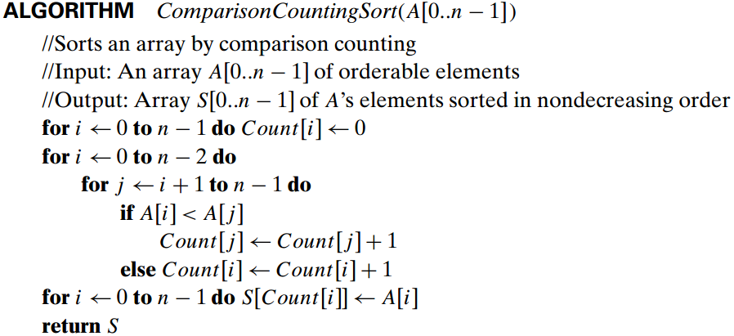
Counting By Sorting
What is Θ(g(n))?

Slide 29
Efficiency
Number of comparisons performed: $C\left(n\right)= \sum_{i=0}^{n−2}{\sum_{j=i+1}^{n−1}{1}} = \sum_{i=0}^{n−2}{\left(n−i−1\right)}$ $= \frac{n(n−1)}{2}= θ\left(n^{2}\right)$
Comparable to Selection Sort in comparisons.
Minimum number of moves.

Slide 30
Distribution Counting Sort
Assume list only has two elements: 0 or 1
Use counting approach to find number of 0’s and 1’s.
Then write x 0’s followed by y 1’s. Or copy.
Can generalize to more possible values: distribution counting sort.
Smallest value: 0 … F[0]-1 in new array
Next value: F[0] … F[1]-1 in new array
…

Slide 31
Distribution Counting Sort
Consider sorting following array:
13 | 11 | 12 | 13 | 12 | 12
[0] | [1] | [2] | [3] | [4] | [5]
[0] | [1] | [2] | [3] | [4] | [5]
Array Values | 11 | 12 | 13
Frequencies | 1 | 3 | 2
Distribution Values | 1 | 4 | 6

Slide 32
Distribution Counting Sort
Consider sorting following array:
13 | 11 | 12 | 13 | 12 | 12
[0] | [1] | [2] | [3] | [4] | [5]
[0] | [1] | [2] | [3] | [4] | [5]
Array Values | 11 | 12 | 13
Frequencies | 1 | 3 | 2
Distribution Values | 1 | 4 | 6

Slide 33
Distribution Counting Sort
Consider sorting following array:
13 | 11 | 12 | 13 | 12 | 12
[0] | [1] | [2] | [3] | [4] | [5]
 |  |  | 12
[0] | [1] | [2] | [3] | [4] | [5]
Array Values | 11 | 12 | 13
Frequencies | 1 | 3 | 2
Distribution Values | 1 | 3 | 6

Slide 34
Distribution Counting Sort
Consider sorting following array:
13 | 11 | 12 | 13 | 12 | 12
[0] | [1] | [2] | [3] | [4] | [5]
 |  |  | 12
[0] | [1] | [2] | [3] | [4] | [5]
Array Values | 11 | 12 | 13
Frequencies | 1 | 3 | 2
Distribution Values | 1 | 3 | 6

Slide 35
Distribution Counting Sort
Consider sorting following array:
13 | 11 | 12 | 13 | 12 | 12
[0] | [1] | [2] | [3] | [4] | [5]
 |  | 12 | 12
[0] | [1] | [2] | [3] | [4] | [5]
Array Values | 11 | 12 | 13
Frequencies | 1 | 3 | 2
Distribution Values | 1 | 2 | 6

Slide 36
Distribution Counting Sort
Consider sorting following array:
13 | 11 | 12 | 13 | 12 | 12
[0] | [1] | [2] | [3] | [4] | [5]
 |  | 12 | 12
[0] | [1] | [2] | [3] | [4] | [5]
Array Values | 11 | 12 | 13
Frequencies | 1 | 3 | 2
Distribution Values | 1 | 2 | 6

Slide 37
Distribution Counting Sort
Consider sorting following array:
13 | 11 | 12 | 13 | 12 | 12
[0] | [1] | [2] | [3] | [4] | [5]
 |  | 12 | 12 |  | 13
[0] | [1] | [2] | [3] | [4] | [5]
Array Values | 11 | 12 | 13
Frequencies | 1 | 3 | 2
Distribution Values | 1 | 2 | 5

Slide 38
Distribution Counting Sort
Consider sorting following array:
13 | 11 | 12 | 13 | 12 | 12
[0] | [1] | [2] | [3] | [4] | [5]
 |  | 12 | 12 |  | 13
[0] | [1] | [2] | [3] | [4] | [5]
Array Values | 11 | 12 | 13
Frequencies | 1 | 3 | 2
Distribution Values | 1 | 2 | 5

Slide 39
Distribution Counting Sort
Consider sorting following array:
13 | 11 | 12 | 13 | 12 | 12
[0] | [1] | [2] | [3] | [4] | [5]
 | 12 | 12 | 12 |  | 13
[0] | [1] | [2] | [3] | [4] | [5]
Array Values | 11 | 12 | 13
Frequencies | 1 | 3 | 2
Distribution Values | 1 | 1 | 5

Slide 40
Distribution Counting Sort
Consider sorting following array:
13 | 11 | 12 | 13 | 12 | 12
[0] | [1] | [2] | [3] | [4] | [5]
 | 12 | 12 | 12 |  | 13
[0] | [1] | [2] | [3] | [4] | [5]
Array Values | 11 | 12 | 13
Frequencies | 1 | 3 | 2
Distribution Values | 1 | 1 | 5

Slide 41
Distribution Counting Sort
Consider sorting following array:
13 | 11 | 12 | 13 | 12 | 12
[0] | [1] | [2] | [3] | [4] | [5]
11 | 12 | 12 | 12 |  | 13
[0] | [1] | [2] | [3] | [4] | [5]
Array Values | 11 | 12 | 13
Frequencies | 1 | 3 | 2
Distribution Values | 0 | 1 | 5

Slide 42
Distribution Counting Sort
Consider sorting following array:
13 | 11 | 12 | 13 | 12 | 12
[0] | [1] | [2] | [3] | [4] | [5]
11 | 12 | 12 | 12 |  | 13
[0] | [1] | [2] | [3] | [4] | [5]
Array Values | 11 | 12 | 13
Frequencies | 1 | 3 | 2
Distribution Values | 0 | 1 | 5

Slide 43
Distribution Counting Sort
Consider sorting following array:
13 | 11 | 12 | 13 | 12 | 12
[0] | [1] | [2] | [3] | [4] | [5]
11 | 12 | 12 | 12 | 13 | 13
[0] | [1] | [2] | [3] | [4] | [5]
Array Values | 11 | 12 | 13
Frequencies | 1 | 3 | 2
Distribution Values | 0 | 1 | 4

Slide 44
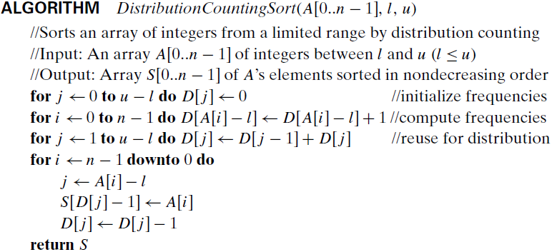
Distribution Counting Sort
What is Θ(g(n))?

Slide 45
Distribution Counting Sort
Θ(n)
Faster than quicksort!!
Relies on nature of input as well as trading space for time.

